Slide 1
Geography Mentor Meeting/ Update
Agenda
Support for mentors
Important dates
Placement 2 requirements
UoY Geography PGCE Curriculum Overview
Assignment 3 Overview
Core Content Framework (CCF) development task
AOB
10.2.22
Georgia Ramsay

Slide 2
Support for Mentors
UoY PGCE mentor website
Mentor handbook
Geography mentor resources/ pack
Geography subject specific target examples
PebblePad explained - video 9 mins
Shared mentor Google Drive
Regular mentor updates (every 2 weeks)
Quick response to emails regarding any concerns regarding a trainee

Slide 3
2. Important Dates
Friday 25th March - Review 3 (completed on PebblePad)
Friday 25th March - Trainees in university
w/c 18th April - Commence school visits (Leeds and Doncaster)
25th April - 9th May - School visits (external examiner visits w/c 2nd May)
Friday 13th May - Review 4 (completed on PebblePad)
Friday 20th May - Trainees final day in placement school
Friday 27th May - Assignment 3 deadline

Slide 4
3. Placement 2 Requirements
1
Timetable
2
Mentor Meetings
3
Lesson Observations
Quickly build to a 50-60% timetable (12-13 hours per week).
Trainees must teach across at least 2 key stages
After Easter, trainees should undertake a further 20-25% of timetabled involvement in teaching 70-80% (15-18 hours per week)
Trainees can teach other subjects also (majority of lessons - geog)
Weekly meeting (one hour in total)
2-3 targets per week, with links to the CCF
Trainee completes the weekly mentor meeting template (verified by mentor) and uploads onto PebblePad
One formal lesson obs per week on UoY template (on website and PebblePad)
Informal lesson feedback to be recorded in the trainees reflections book (exercise book) using WWW/ EBI
Host teacher remains in the class (or nearby once trainee is established)

Slide 5
Example Placement 2 Timetable
 | Mon | Tues | Wed | Thurs | Fri
Reg | 8Gr | 8Gr | 8Gr | 8Gr | 8Gr
P1 |  | 7Cf | 9X1 | 8Md | 10 Y3
P2 | 7Cf |  | 7Hv | Yr 12 TT | 8Kl
P3 | 8Kl | 9X1 |  | 7Hv | 9Z1
P4 | 9Z1 |  | 10 Y3 |  | Mentor meet
Reg | 8Gr | 8Gr | 8Gr | 8Gr | 8Gr
P5 | 8Md | Yr 12 TT |  | 10Y3 | Yr 10 intervent.
First lesson with each class is an observation
Take over Yr 7,8, 9 before Easter
Take over Yr 10 after Easter
Occasional solo teaching/ team teaching of Yr 12 before the end of placement

Slide 6
3. Placement 2 Requirements
4
Learning Plans and Post Lesson Reflection
5
PebblePad
Trainees must use the University of York templates provided until you are secure with the planning process
Learning plans and resources submitted for every lesson to host teacher, 48 hours in advance of the lesson
A post lesson brief reflection/ evaluation needs to be completed by the trainee for every lesson taught, with a detailed evaluation once a week
Each week the trainee must upload the following into their PebblePad portfolio:
1 formal lesson observation form
1 full learning plan and resources for the observed lesson
1 full lesson evaluation for the observed lesson
1 mentor meeting record
Trainees should also record any WSI or CA training that they have in school.

Slide 7
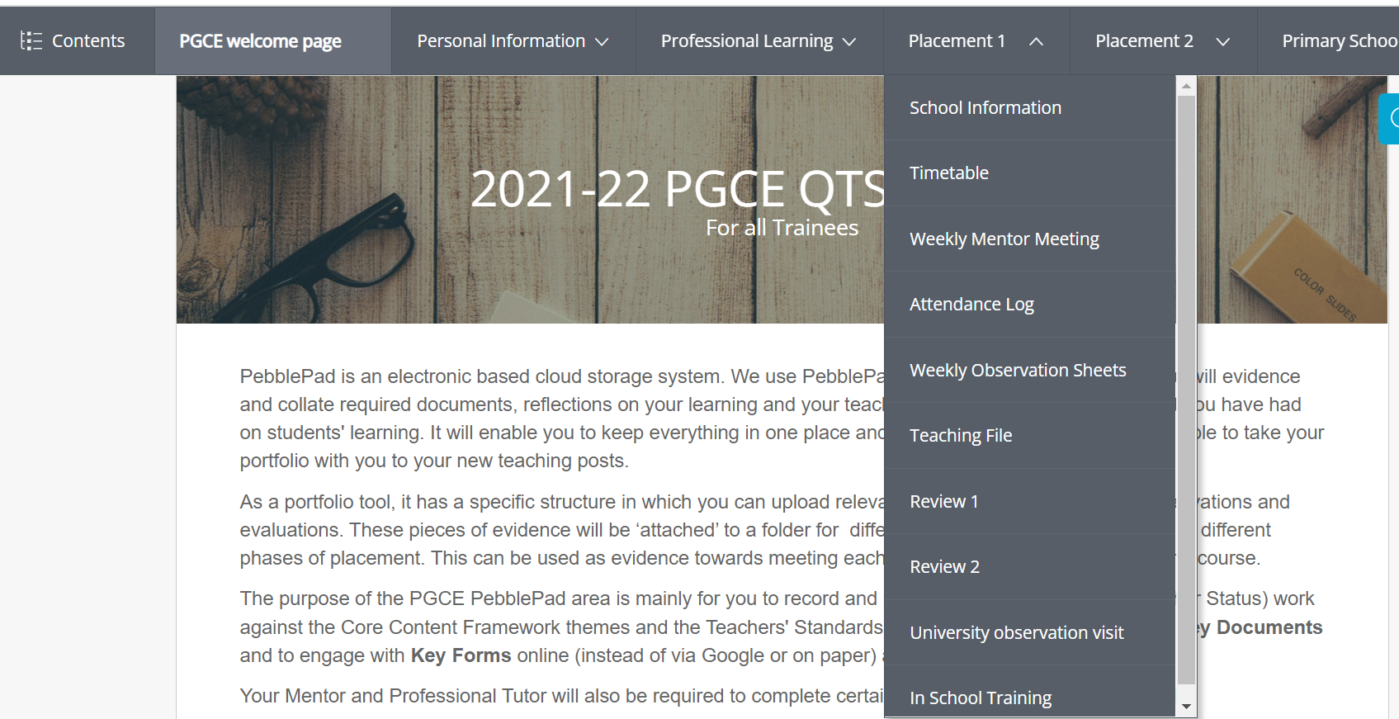

Slide 8
Any questions regarding placement 2 requirements?

Slide 9
4. UoY Geography PGCE Curriculum Overview
Sept - Dec
Key focus on CCF 1,4,7
Induction Phase: 3 days a week at university/ SD hub and 2 days a week in placement 1 school
Assignment 1: What do you consider to be effective teaching and why?
Placement 1 Block 1 (teaching a minimum of 12 solo lessons)
Review 1
Late Dec - mid Feb
Continue embedding CCF 1,4,7 Key focus on CCF 2,5,6
Mid-placement development: 2 weeks, majoritively at university/ SD hub
Assignment 2: Evaluating your planning, teaching and assessment of a small sequence of learning
Placement 1 Block 2 (working up towards a 50% timetable)
Review 2

Slide 10
4. UoY Geography PGCE Curriculum Overview
Mid Feb - March
Continue embedding CCF 2,5,6 and Key focus on CCF 3, 8 & PPC
Transition to new school: 3 days a week at university/ SD hub and 2 days a week in placement 2 school
Placement 2 Block 1 (quickly working up towards a 50%-60%+ timetable)
Assignment 3 (Part A): Conduct your own small-scale classroom-based research (initial focus on reading and existing research) - main launch 25th March
Review 3
April - June
Continue embedding CCF 3,8 & PPC and
Key focus on enrichment
Placement 2 Block 2 (You should undertake a further 20-25% of timetabled involvement so your timetable reaches 70-80%.)
Assignment 3 (Part B): Conduct your own small-scale classroom-based research (carry out own research)
Review 4
2 weeks university/ SD provision - enrichment
2 weeks enrichment placement
Final week - reflection and celebration

Slide 11
Link to detailed session by session
Geography PGCE curriculum plan

Slide 12
5. Assignment 3 Overview
On 25th March, I will be launching Assignment 3 with the trainees (deadline 27th May)
Conduct your own small-scale classroom-based research
Please can I ask mentors to have a conversation with their trainees regarding their ideas for assignment 3 as soon as they are settled into school.
To help with workload, trainees really need to be doing some of their preliminary reading prior to 25th March
25th March - ideally trainees should come with their title.

Slide 13
5. Assignment 3 Overview
Some example titles from last year:
Does enquiry-based learning (EBL) support progress in geography?
How does dialogic teaching affect pupils’ progress in geography?
How can data be used powerfully to help students think geographically in the classroom?
Is whole class feedback more effective at promoting progress in geography than individual feedback?

Slide 14
6. Core Content Framework (CCF) - development task
The CCF represents ‘the minimum entitlement’ of the teacher training year.
Here is a link to the full CCF from the DfE (pages 8-30 most relevant for mentors)
I am confident that the very vast majority of this entitlement is met through a blend of experience from both university and in school, but it would be useful if mentors could familiarise themselves with this entitlement.
What I would like us to explore further is any ideas for ensuring that the full entitlement is met in a way that is coherent and manageable across our partnership schools.

Slide 16
CCF 8

Slide 18
7. Any Other Business?
Mentor profile Google Form - thank you to those who have completed this. Please complete if you have not yet had chance to do this
Ofsted

Slide 19
Ofsted for ITE/ ITT - what this means for us as mentors
We are overdue an inspection (last inspected in 2013, normally a 5-6 year cycle), Ofsted also keen to visit providers where there is a new PGCE
New inspection framework from Sept 2020
When we are inspected by Ofsted, they will want to talk to mentors as part of the UoY partnership.
The ITE Ofsted approach is similar to that of schools and they will be looking at what happens across both the university and school based provision closely to see if our intent is implemented and then has impact.

Slide 20
Ofsted for ITE/ ITT - what this means for us as mentors
By meeting with mentors, Ofsted will want to assess how well we all work together to produce the next generation of competent and confident early career geography teachers.
If it is useful, I have produced a 2-sided summary document, designed to give clarity and consistency of messages across the partnership of schools
This 2 sided summary covers:
our curriculum ambition
how the Core Content Framework (CCF) is addressed through our taught programme (which you then compliment with the school based experience, your weekly meetings and the sessions delivered in school)
how we have addressed previous Ofsted targets
some of the questions we are expecting.

Slide 21
Ofsted for ITE/ ITT - questions we are expecting
How are you supported by the university?
How are you implementing the Core Content Framework (CCF)?
We think there will be a question about the ‘purposeful integration’ of the university and school experience , i.e. ‘the connectedness of the curriculum from subject and centre based training into placement experiences’ - this is where it will be really important to know our curriculum model (slides 9-10)
There is likely to be something around an ‘ambitious curriculum’
There is likely to be something around subject specific pedagogy

